Slide 1
Plan for today
1. Correlated noise matrix
2. Distribution of a parameters for correlated vs uncorrelated noise
3. ON and OFF mosaics, weird stuff

Slide 2
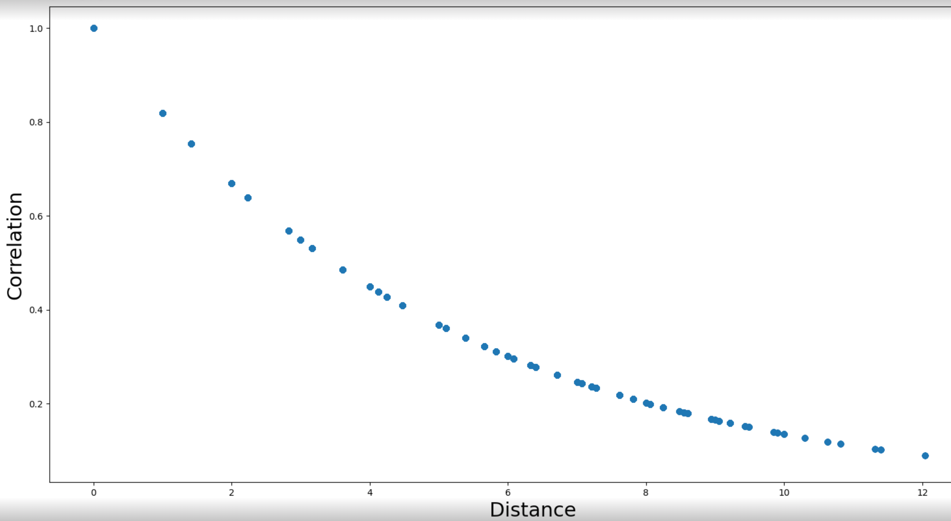
Exponential function

Slide 3
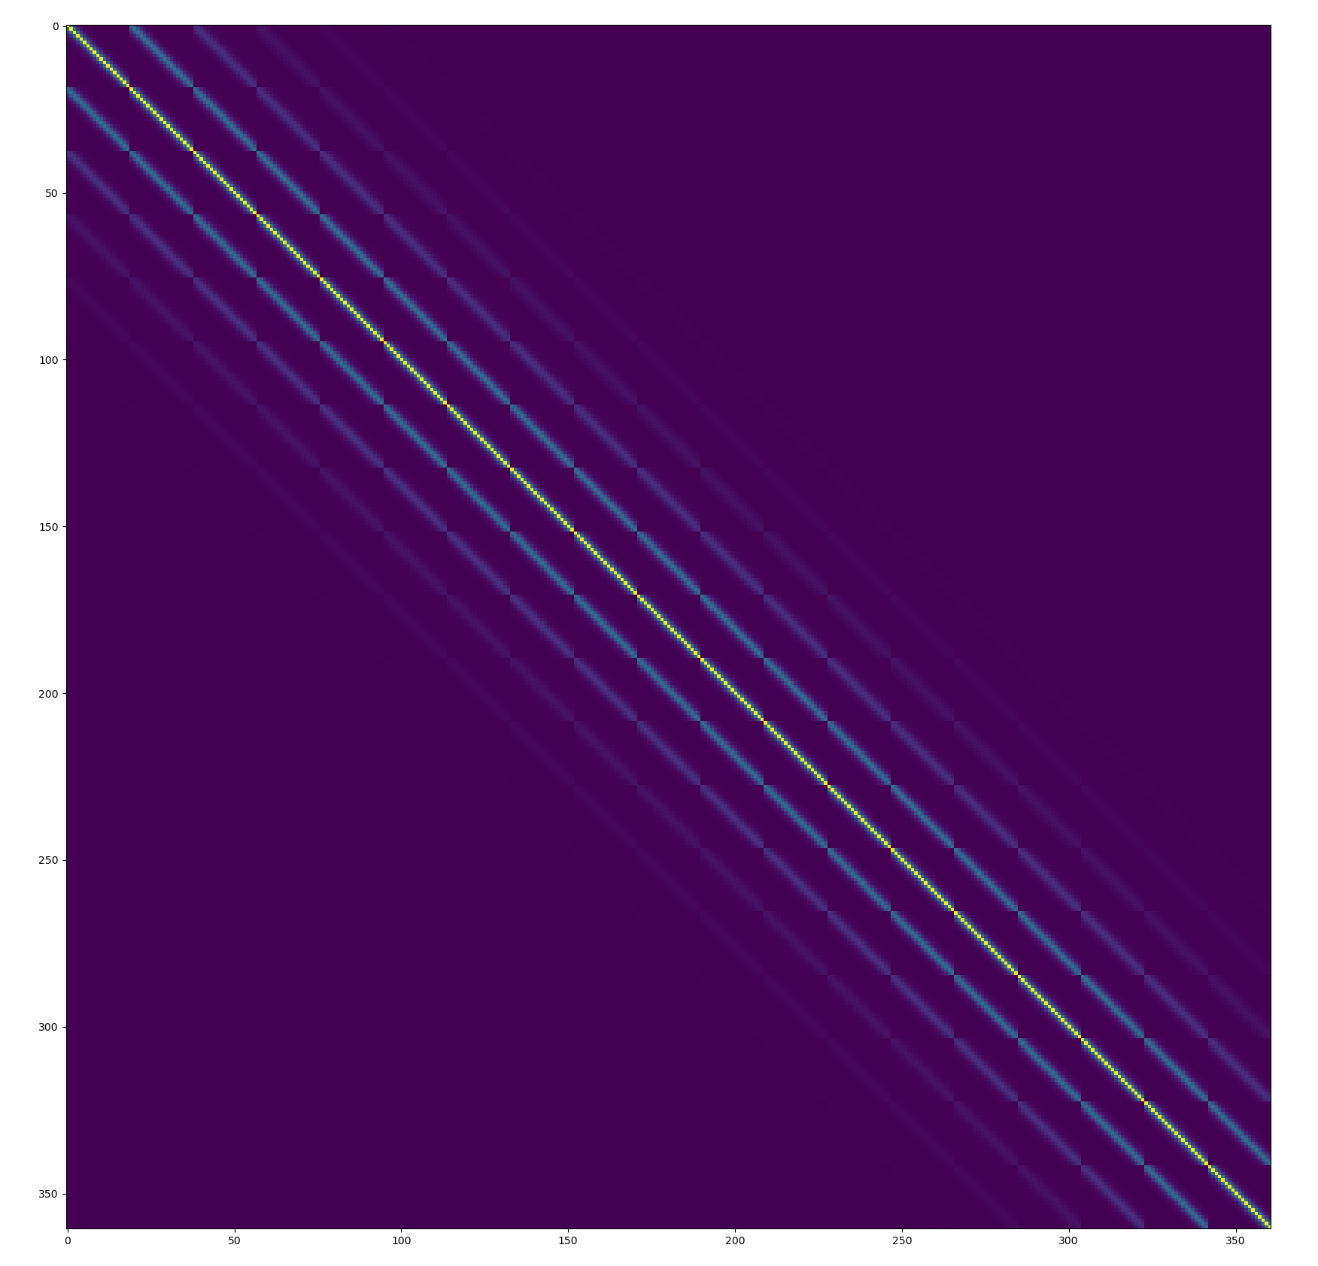
Input noise matrix

Slide 4
How I sample correlated noise from matrix: Cholesky decomposition

Slide 5
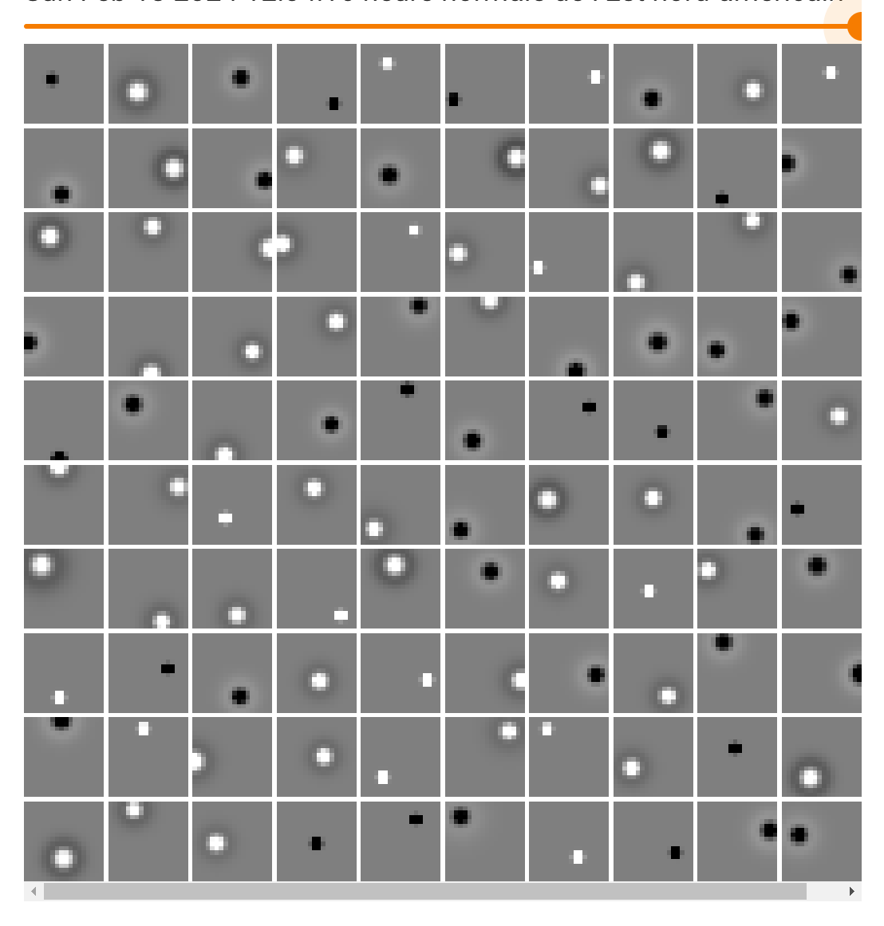
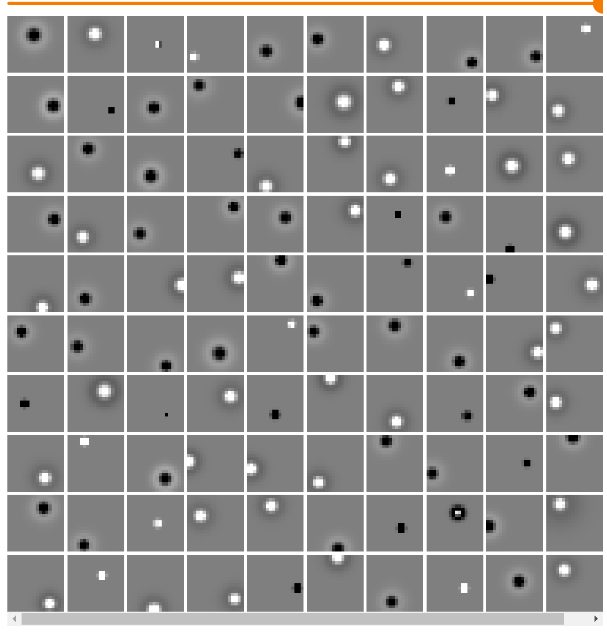
Uncorrelated noise
Correlated noise

Slide 6
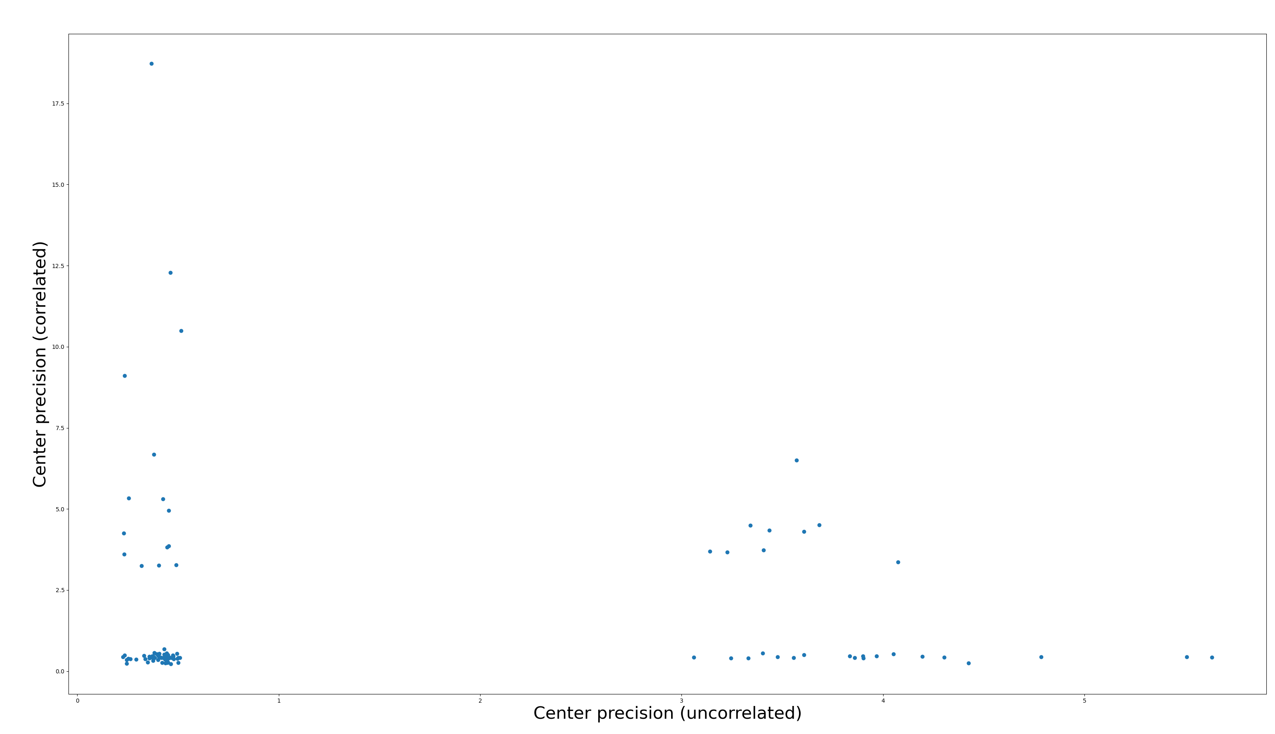

Slide 7
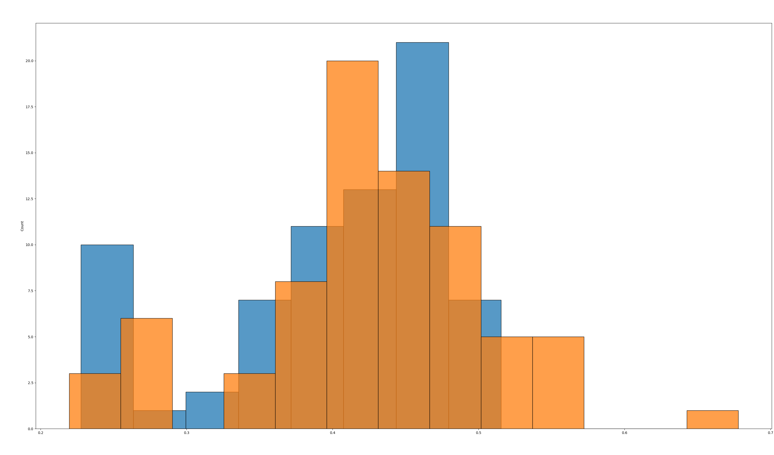
Zoom into low center precision values. Blue = uncorrelated, Orange = correlated

Slide 8
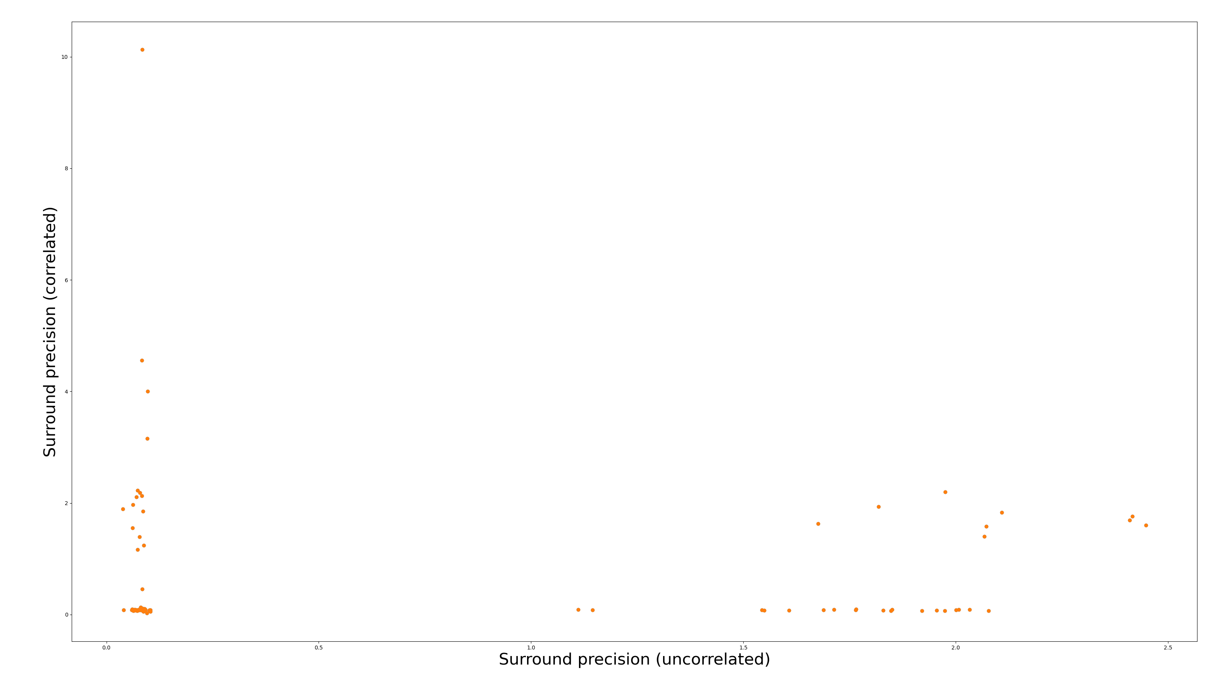

Slide 9
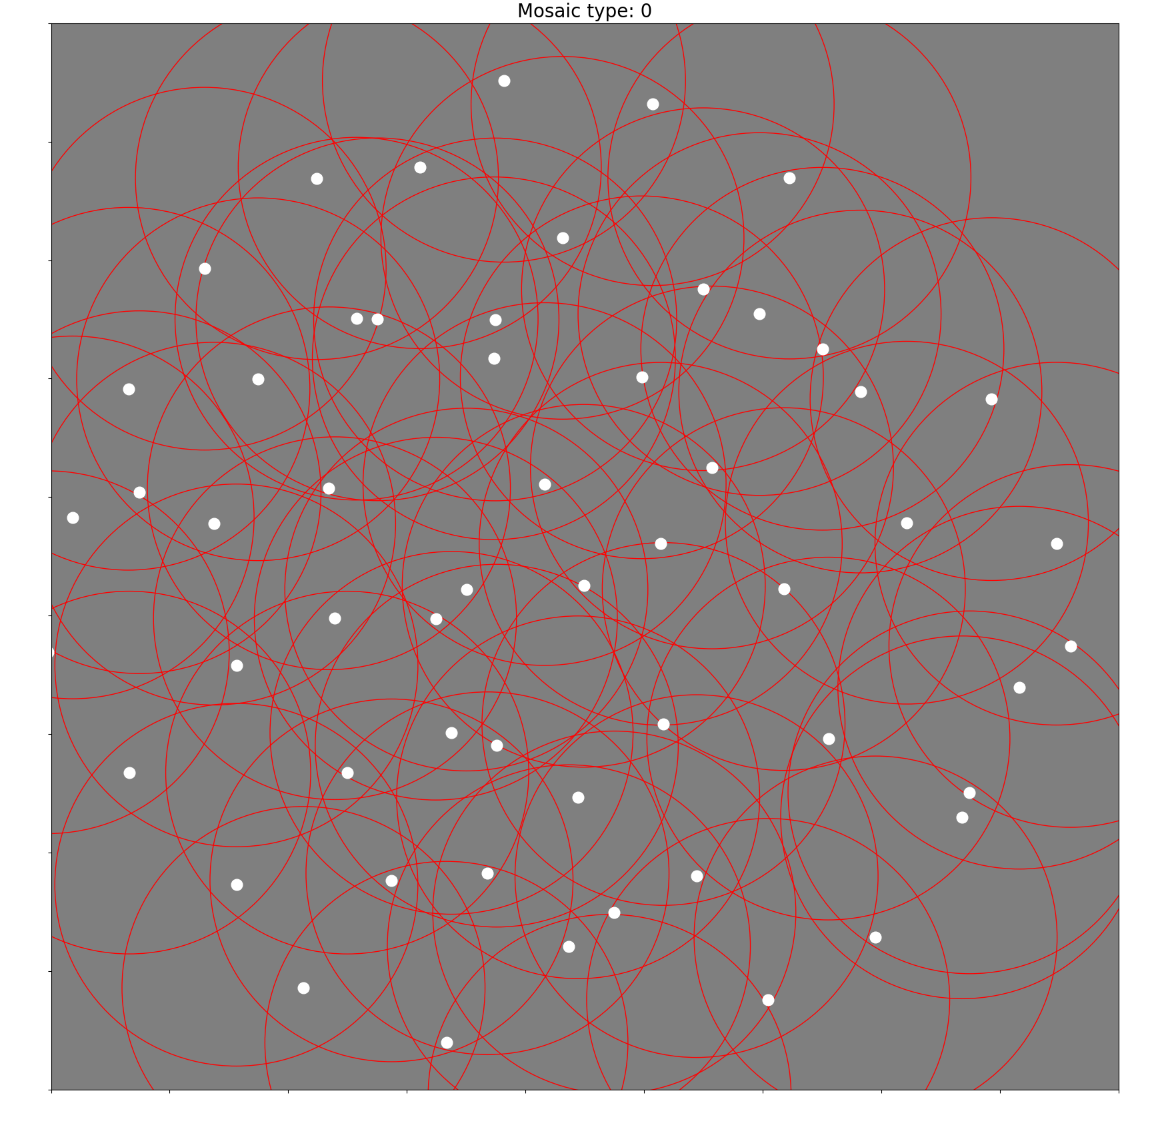
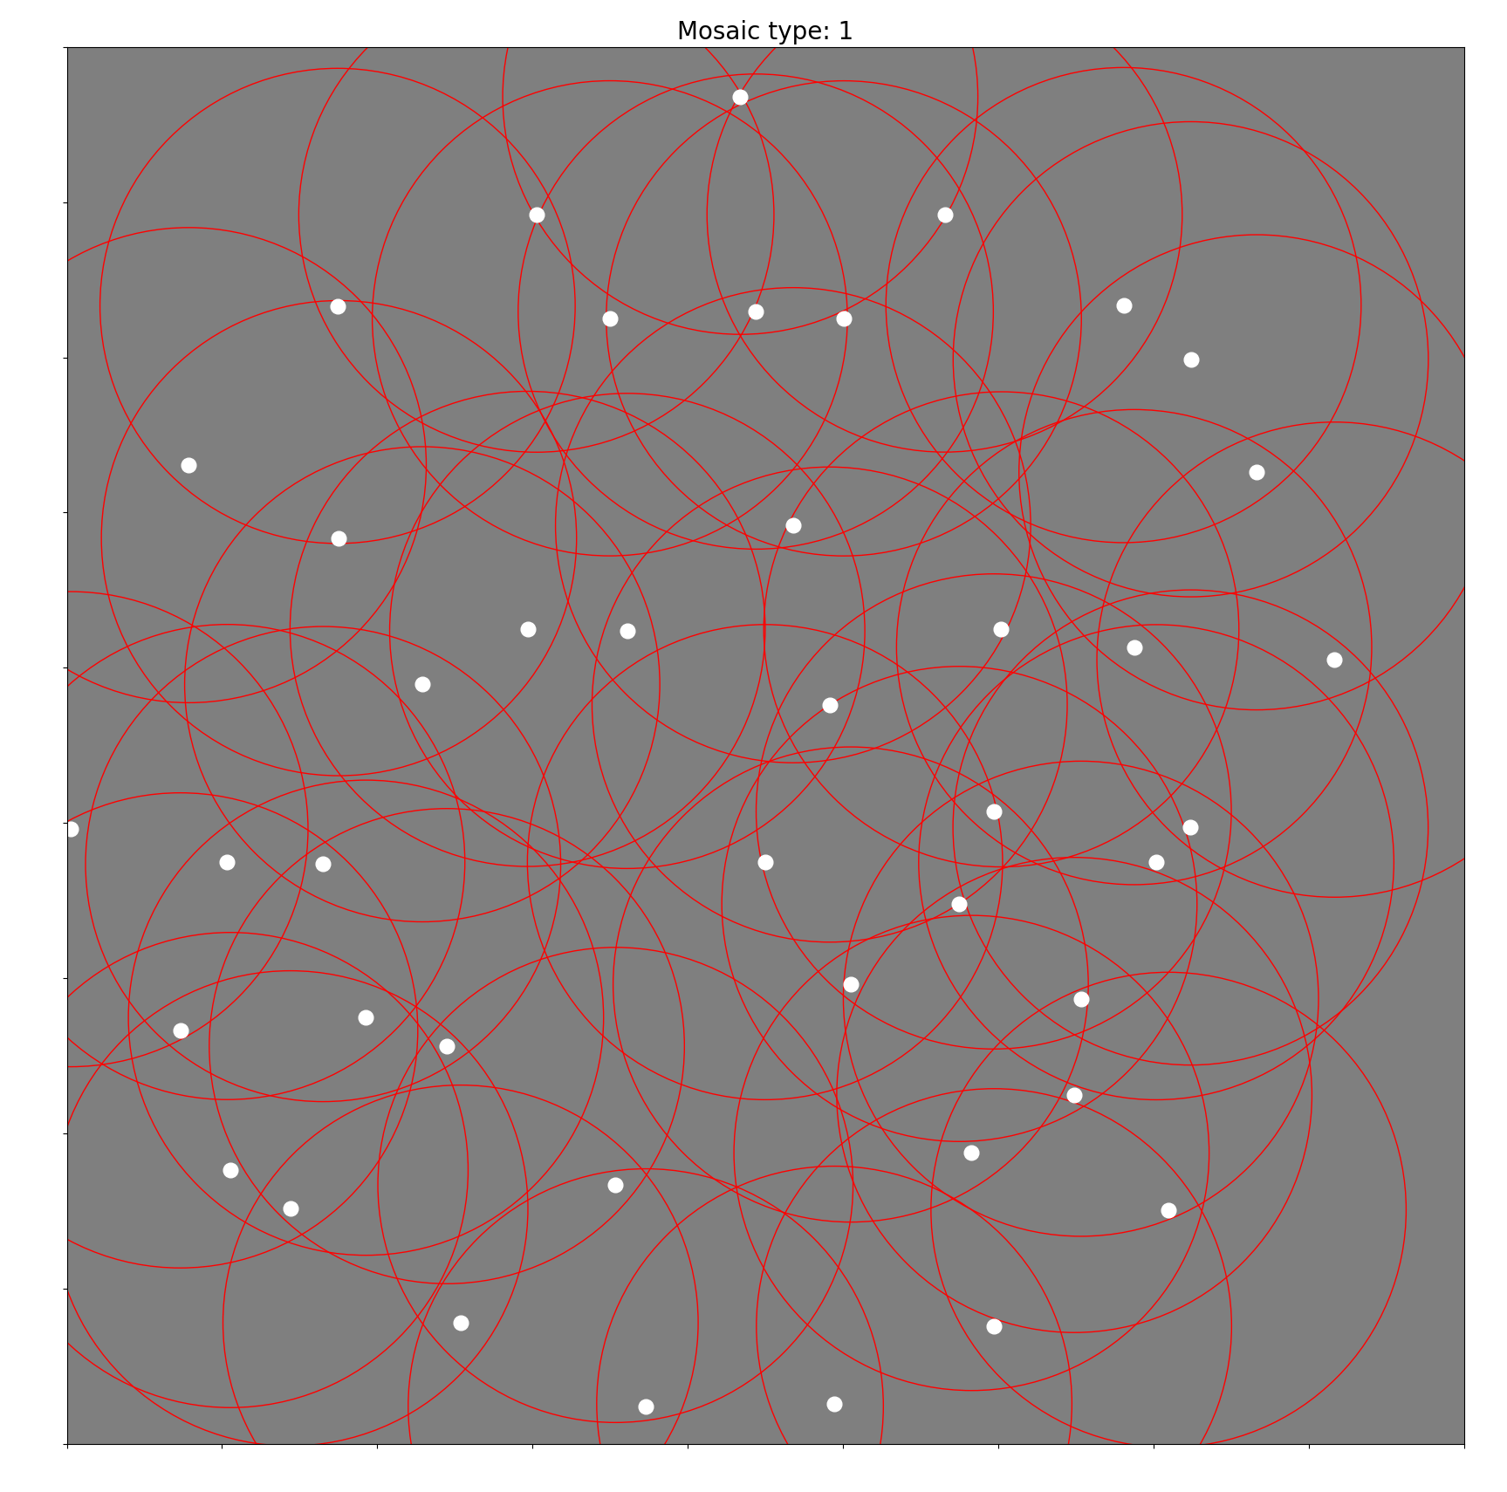
Uncorrelated noise
ON pathway
OFF pathway

Slide 10
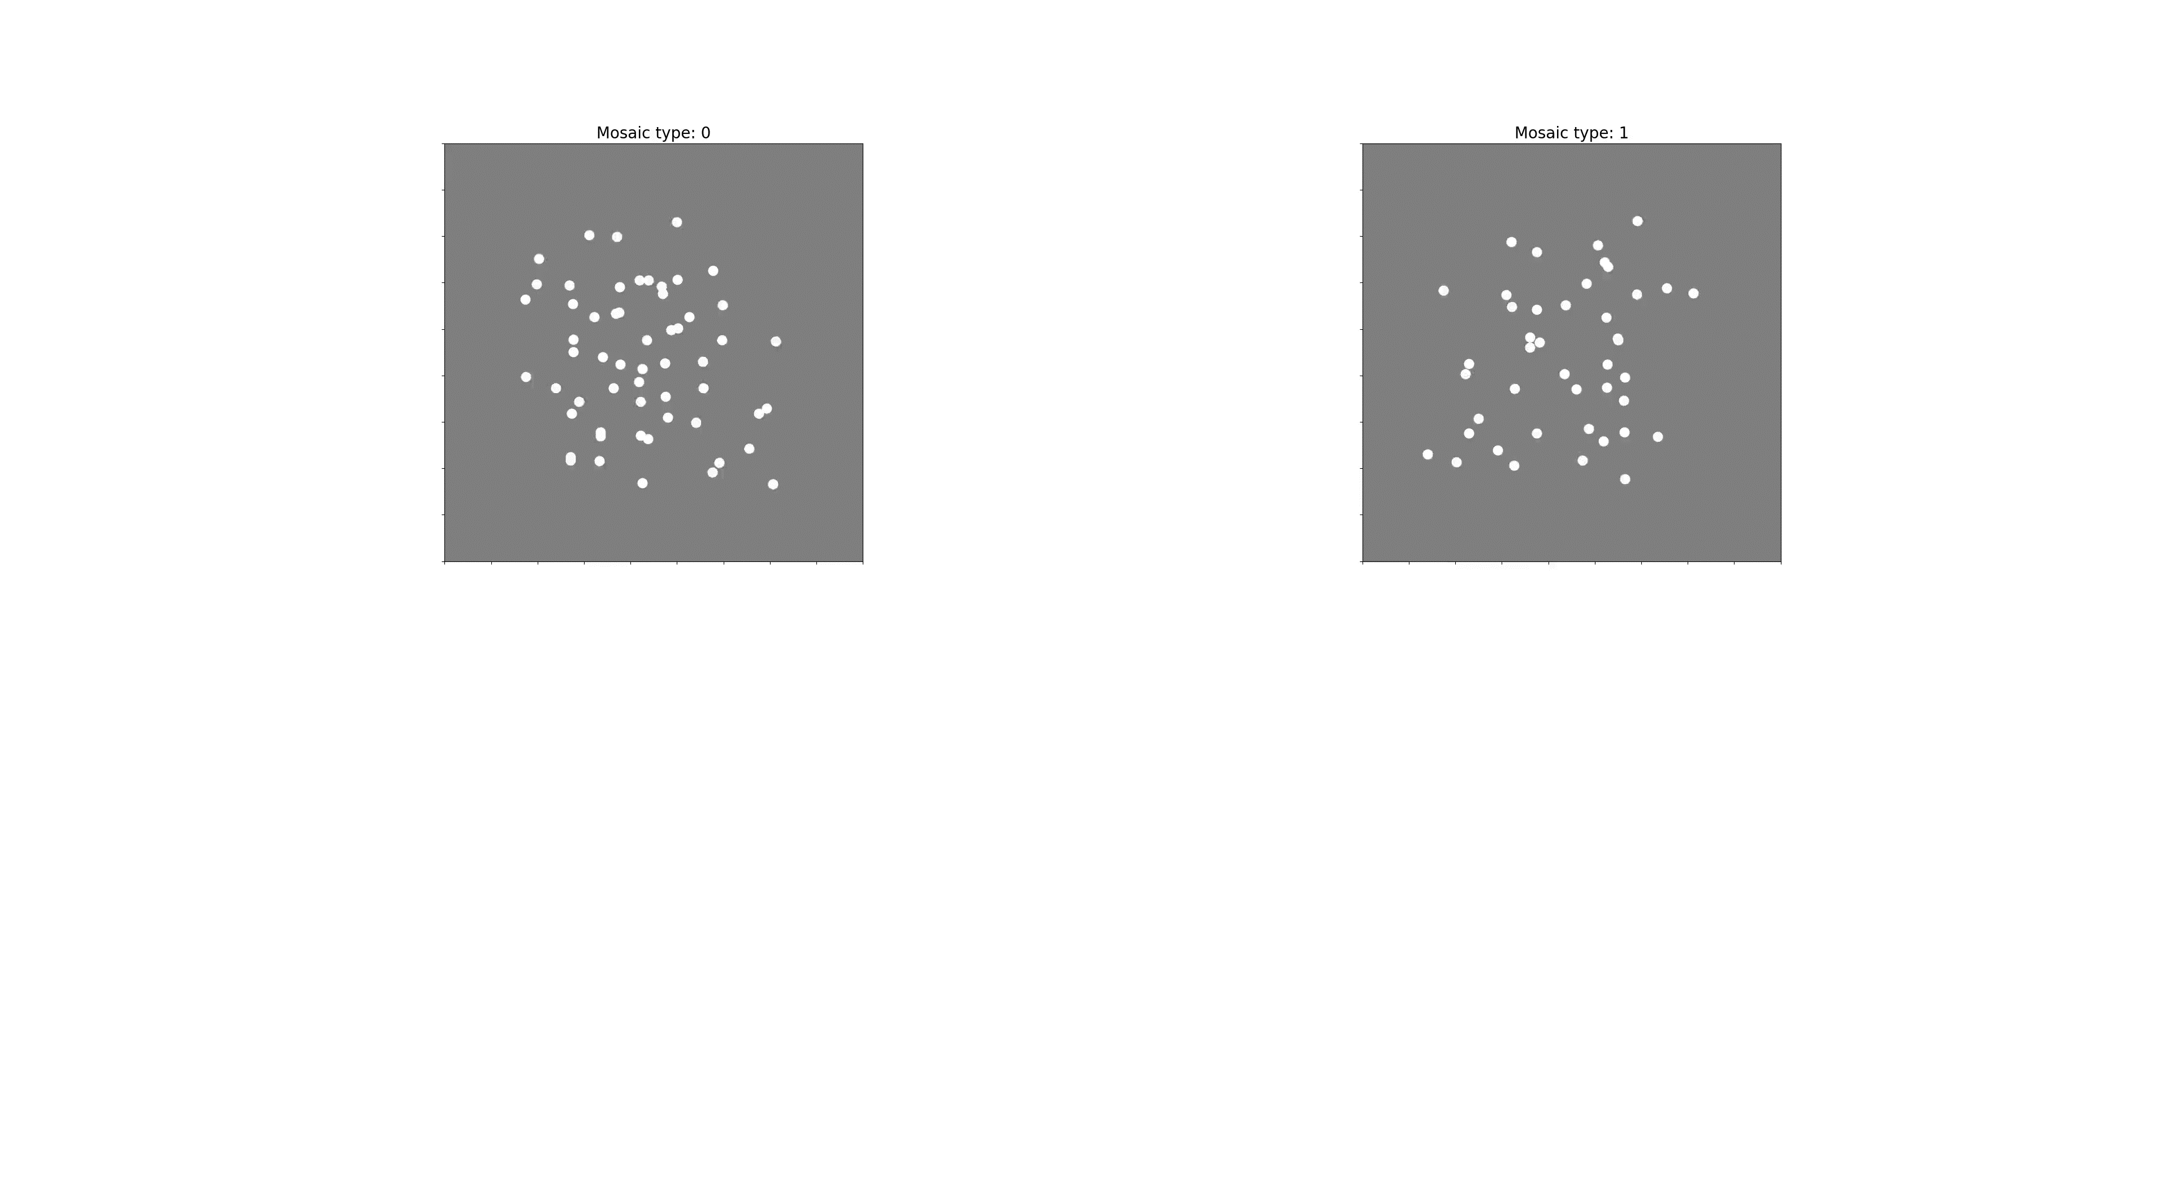

Slide 11
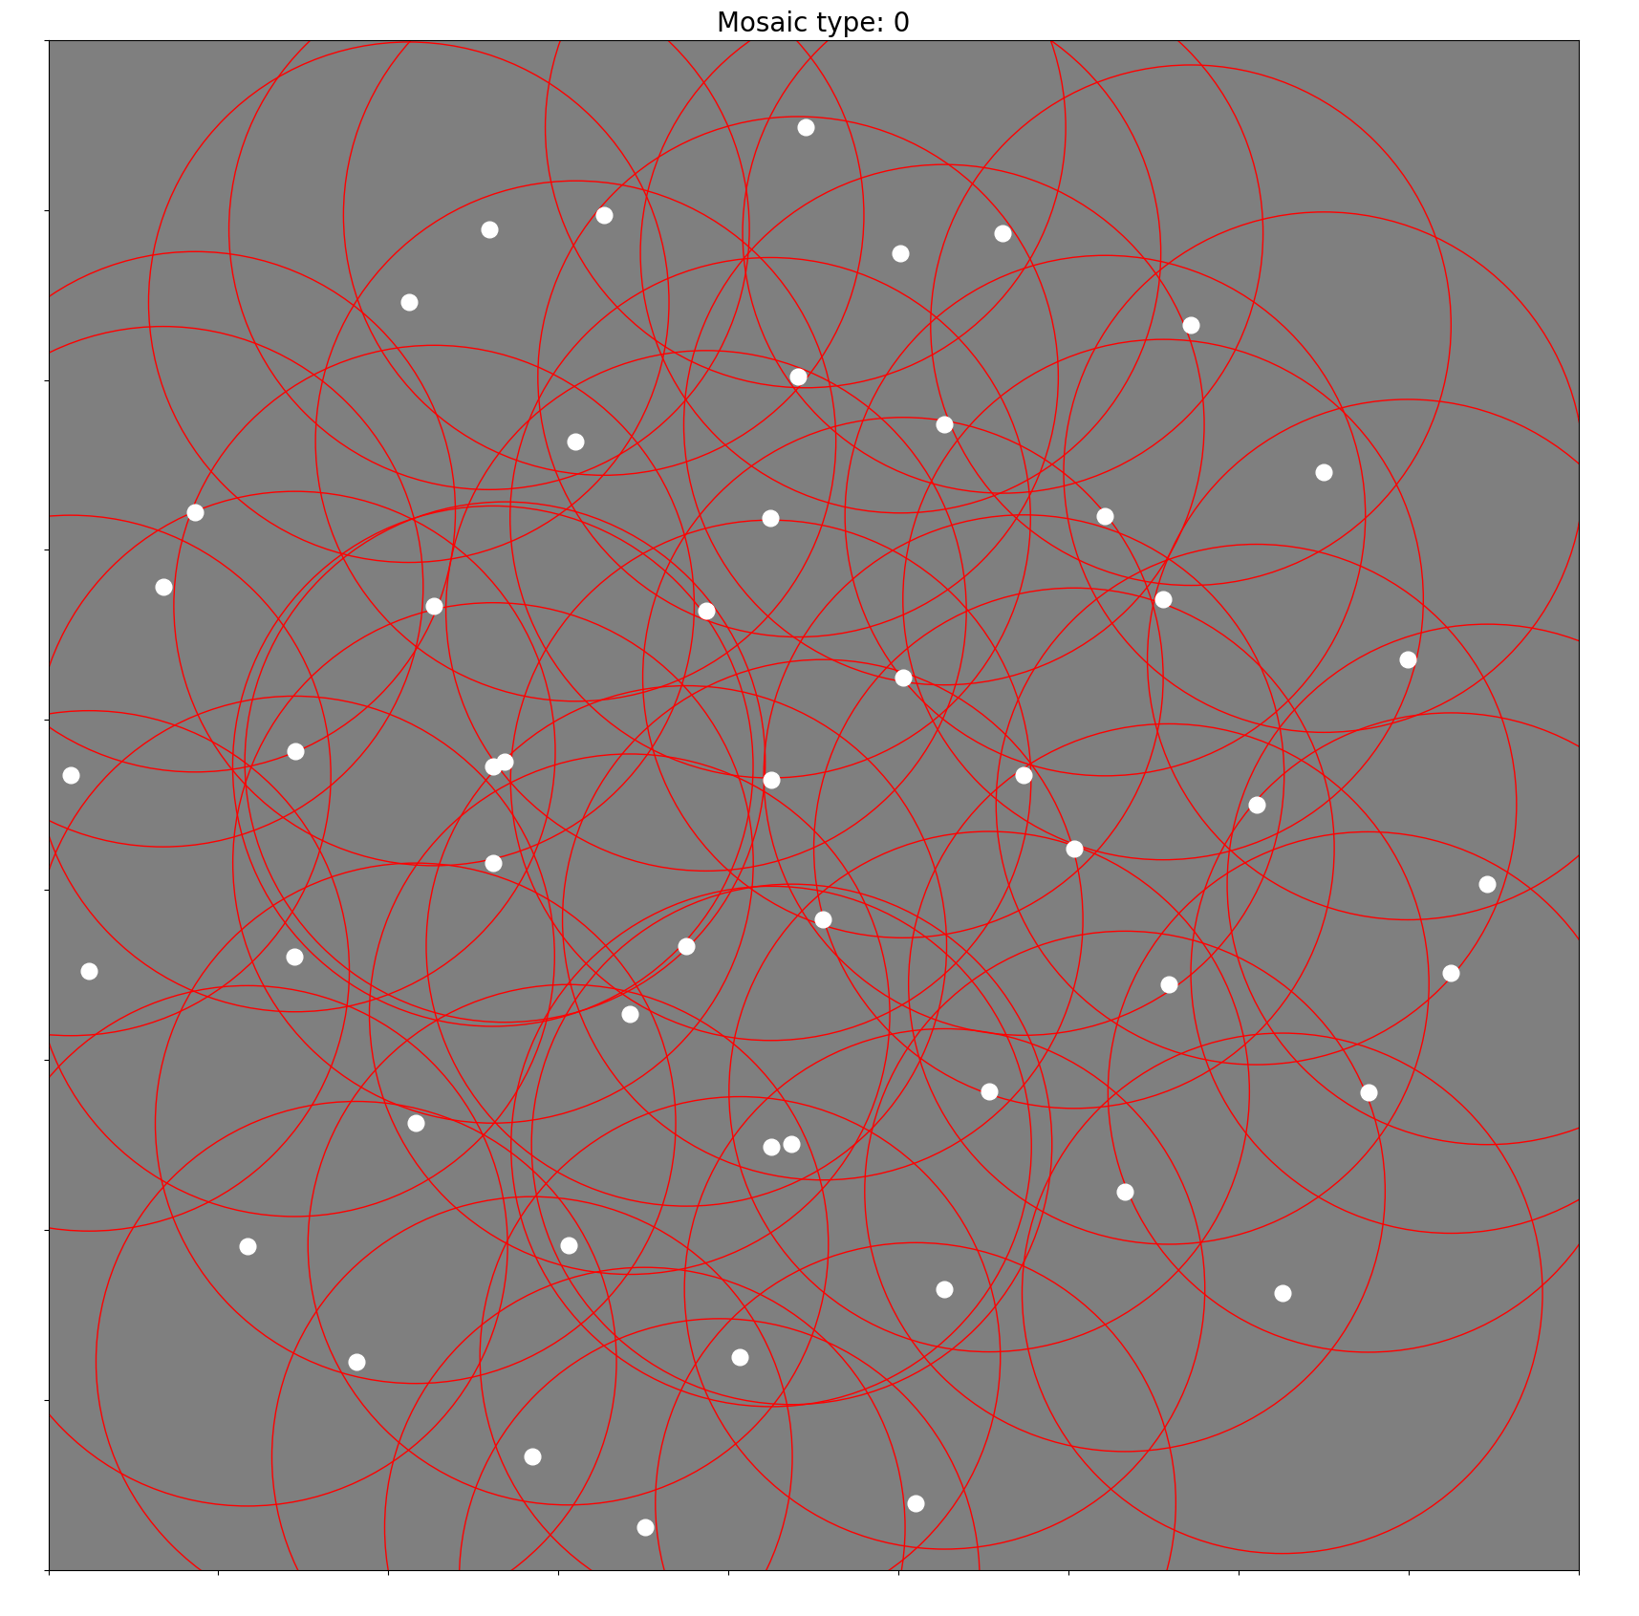
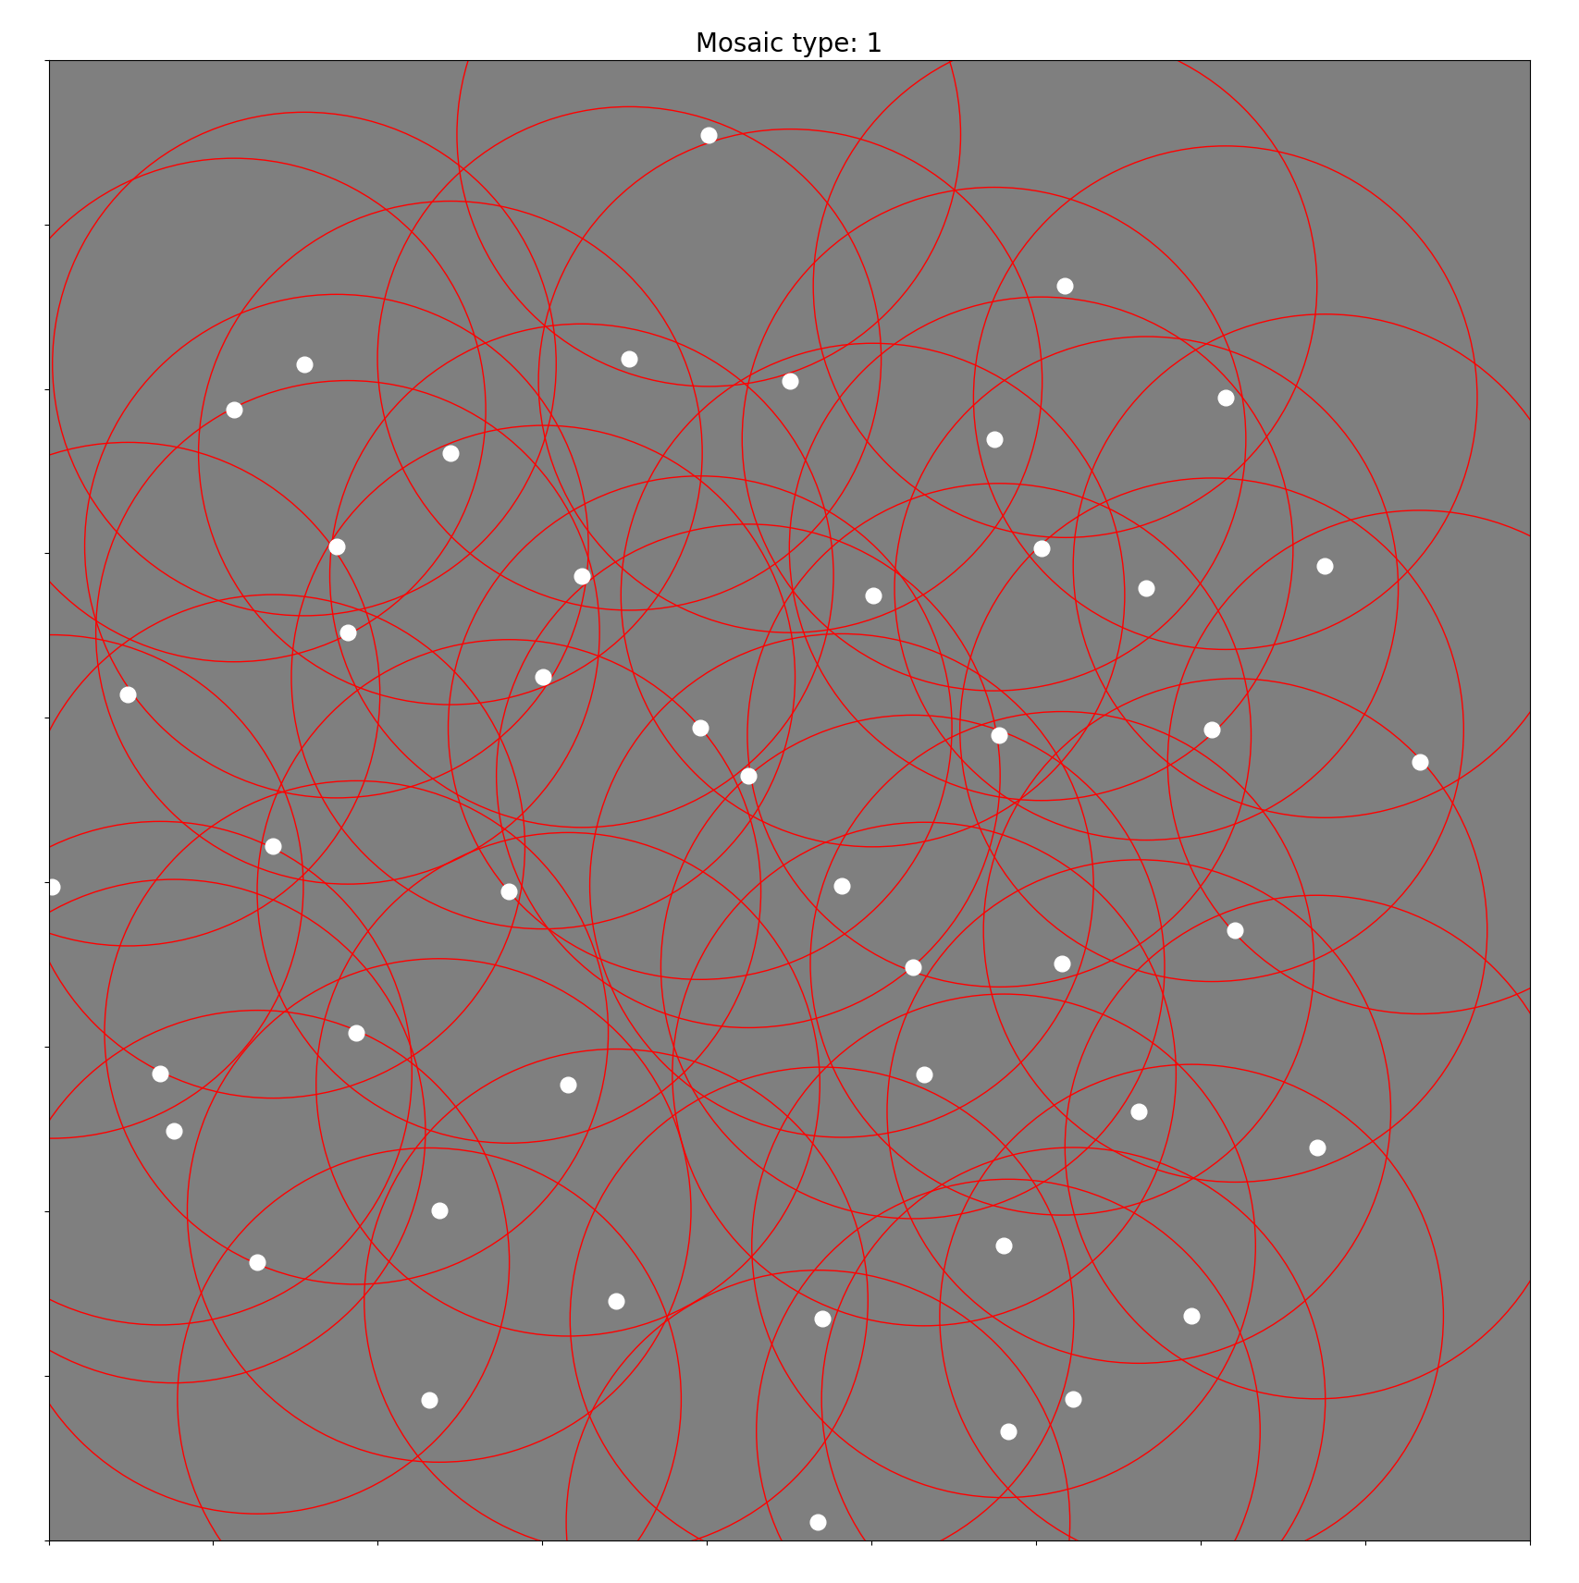
Correlated noise
ON pathway
OFF pathway

